Slide 1

Draft 11.20.11

Slide 2
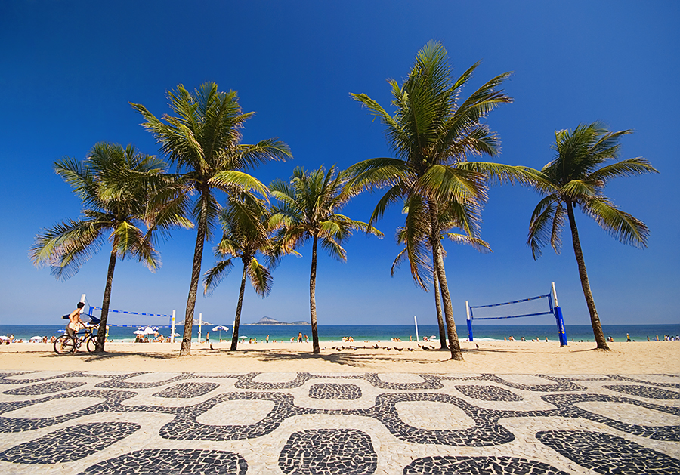
Our Mission:
• To launch RIO RUM, the true taste of Brazil and to build the brand to 100,000 cases by 2016

Slide 3
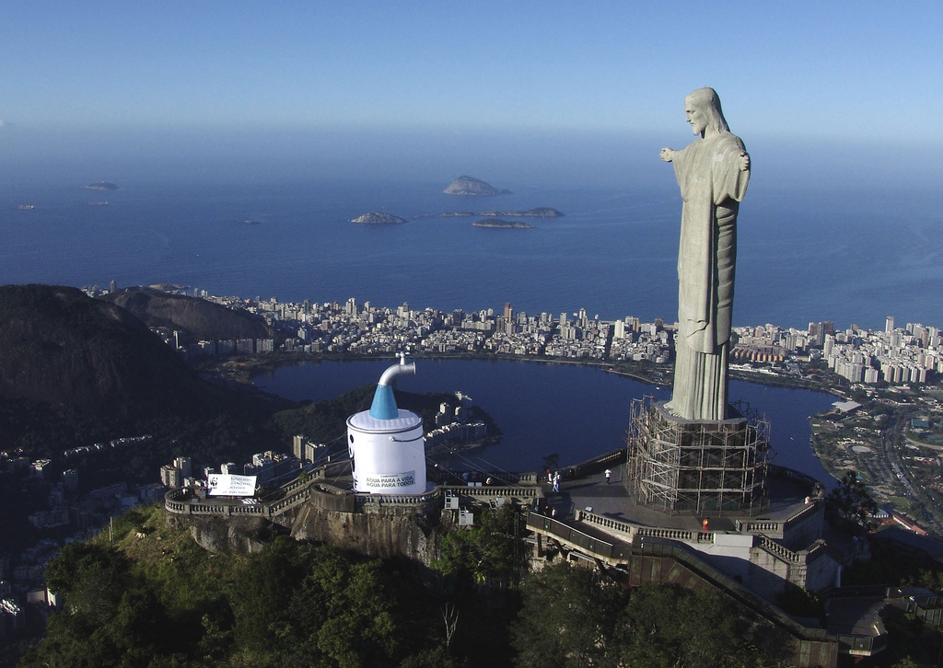
“We will have the great chance to show to the world, a still unknown nation in all its diversity for the billions of people who will see these events. These spectators will not only see the competitions, but also be exposed to the culture and the Brazilian way of life” - Jeanine Pires, President of Embratur

Slide 4
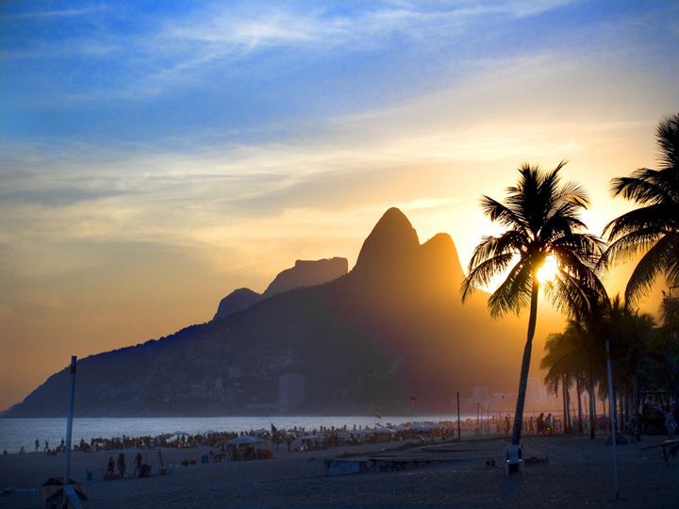
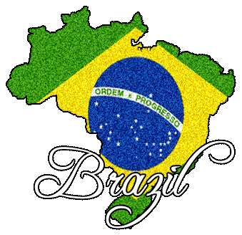
Brazil: A Snapshot
• Brazil is the 5th most populated country in the world with a population of 190 million people.
• According to surveys conducted by Embratur (Brazil’s Tourism Board), to foreign tourists who visited the country, 97.2% intend to return soon; 56.5% had their expectations completely satisfied; and, for 31.7%, it exceeded their expectations in every way.
• A vast mixture of races has made Brazil a culturally rich and at the same time very unique. The result is a happy people, open to everything new, a people one can only find in Brazil.

Slide 5
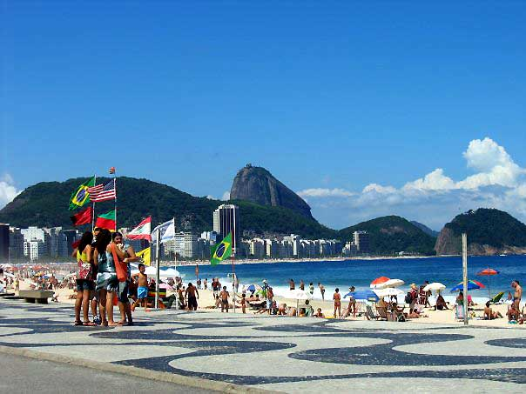
Rio de Janeiro: A Snapshot
• Rio de Janeiro, known as “Cidade Maravilhosa” or “The Marvelous City” is the second largest in Brazil and the 26th largest city in the world.
• Inhabited by 6.3 million people known as “Cariocas”, it is the most visited city in the southern hemisphere with 1.4 million tourists annually.
• Known for its gorgeous beaches, natural beauty and Carnaval, it is home to Sugarloaf Mountain as well as the Corcovado. More commonly known as “Christ the Redeemer.” the Corcovado is the largest art deco statue in the world and one of the New Seven Wonders in The World.

Slide 6
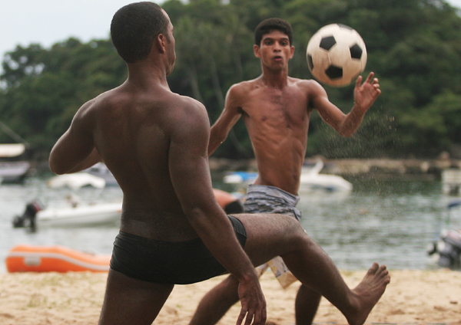


2014 FIFA
World Cup
•Brazil is futbol!
• In June 2014, The most watched TV sport returns to South America for the first time since 1978.
• According to FIFA, Brazil is the most watched international team due to the “Samba” style of play and unparalleled success with five FIFA cup wins.
• Viewership of the 2010 World Cup reached nearly 8 billion viewers (112 million in the US) exceeding total viewership by 2% over 2006.

Slide 7
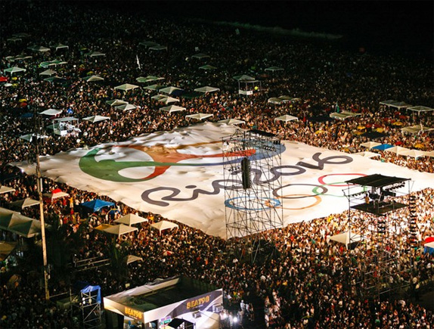
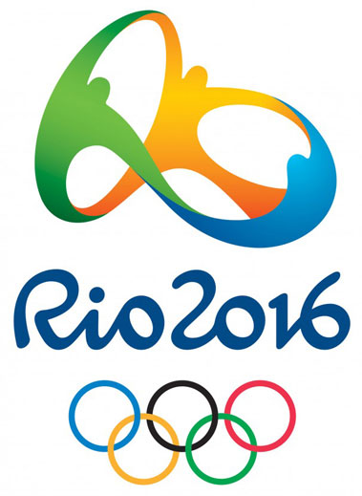
Rio de Janeiro 2016 Olympics
• In 2016, the biggest sporting event in the world will take place for the first time in South America, playing host to more than 10,500 athletes from 205 nations competing in 28 sports.
• Over 7 million tickets will be sold for the 30 venue event.
• Nearly 4.7 billion people tuned into the 2008 Beijing Olympic Games (211 million in the US- the most-viewed event in American television history!) outpacing the 2004 games by 21%.
• Investment by China raised host city awareness from 57% in May 2007 to 79% in May 2008.

Slide 8
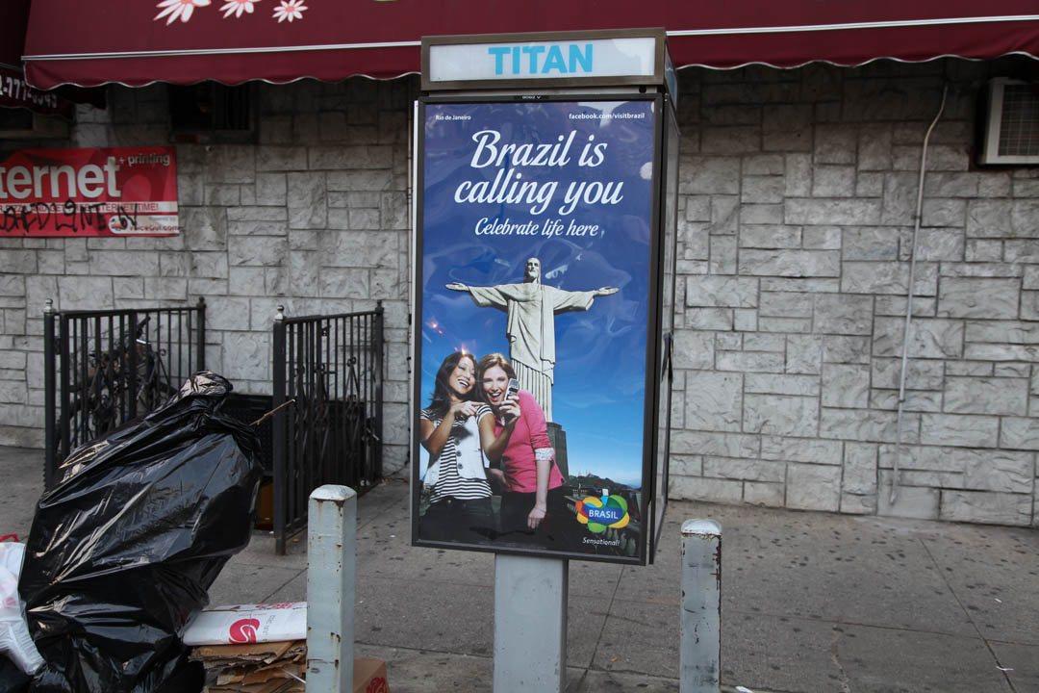
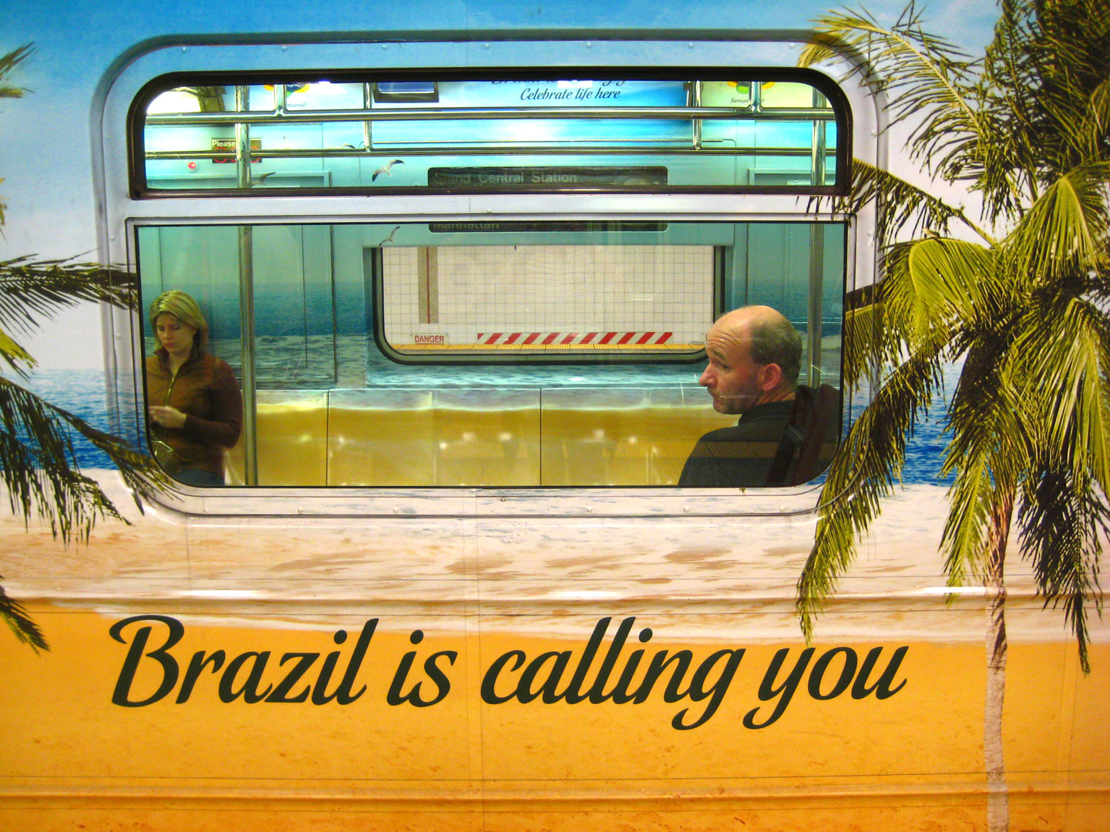

International Tourism Marketing
According to Embratur, (Brazil’s Tourism Board) in 2009 plans call for:
• A $107 million multimedia campaign entitled “Brazil Sensational” will reach over 400 million people in over 100 countries. Americans are the main targets as the United States is the second largest source of tourists to Brazil behind Argentina.
http://www.youtube.com/visitbrasil
• 1.4 million tourists visit Rio de Janeiro every year and this is expected to more than double, increasing to 3.3 million. For Brazil, the goal is to increase the number from 5 to 10 million visitors annually.
• Foreign Tourist Spending will see an increase of 304% to $17.6 billion.

Slide 9
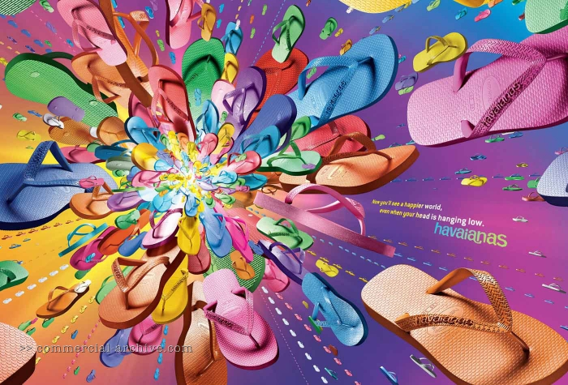
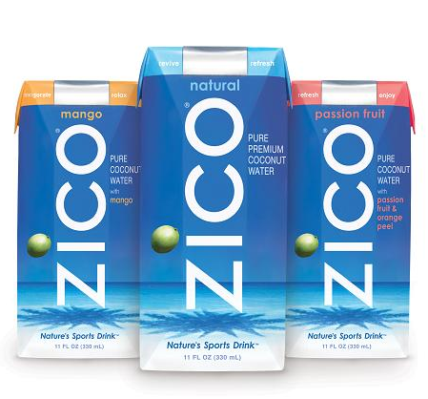
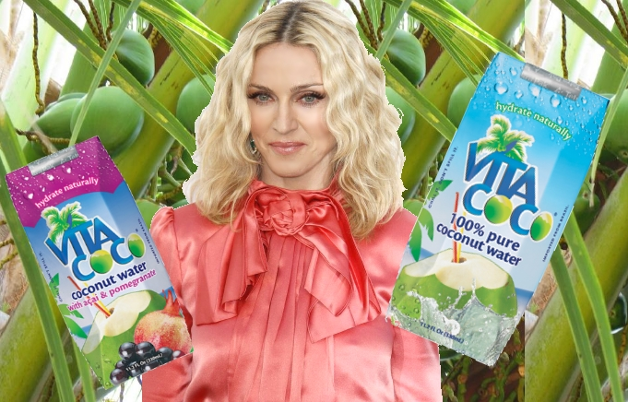
Economics & Exports
• Brazil has the highest GDP in Latin America.
• According to the International Monetary Fund and the World Bank, Brazil has the 9th largest economy in terms of purchasing power parity and 10th in terms of market exchange rates.
• Brazil is the 18th largest supplier of goods imports to the US in 2010.
• From Havaianas to coffee and branded coconut water, U.S. imports from Brazil totaled $23.9 billion in 2010, a 19.2% increase ($3.8 billion) from 2009, and up 175% over the last 16 years!

Slide 10
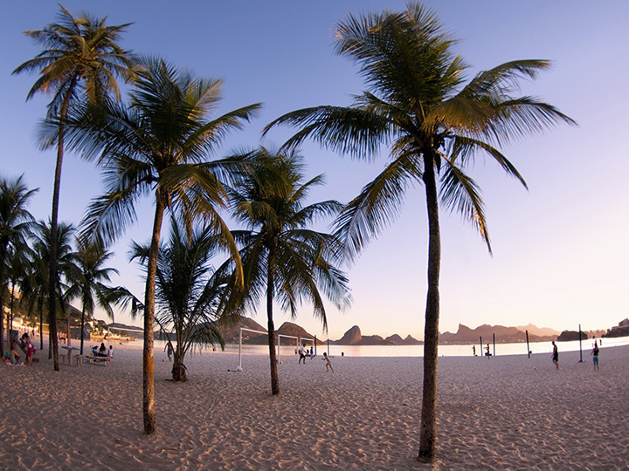
Key Trends & Category Overview

Slide 11

Key Macro Trends
• An Aging Population: There’s 70 million Millennials out there (born between 1980 and 2000), including 20 million who have yet to come of legal drinking age. Clearly, this demographic represents a tremendous amount of purchasing power
• Tolerance for Alternative Lifestyles: findings from the latest Pew Research Center political typology survey, a majority of Americans (58%) say that homosexuality should be accepted, rather than discouraged, by society.
• New Transparency: Social networks have changed the way companies connect with their consumers, allowing them to give customers information immediately and allowing them to engage in conversation.
• ”Me in Media”: We have entered into the conversation economy where old media rules no longer apply. Consumers control time, place and format in which media is consumed. Furthermore, consumers are no longer satisfied with just watching but participating in media generation.

Slide 12
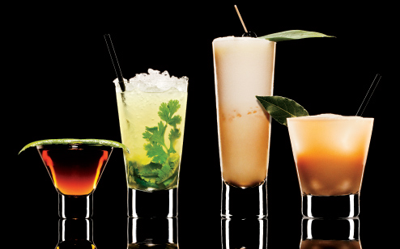
Key Spirits Trends
• Adult Cocktails: pre-mixed cocktails that riff on classics. “Healthy Cocktails” with goji, acai and superfruits sweetened with alternatives such as agave syrup, cane sugar and stevia
• Herbal Infusions: More herbally infused beverages and cocktails on the horizon. While still somewhat in the novelty stage, can be used to create drinks that are less sweet than fruit based cocktails
• Nuevo Latino Culinary Culture: As Latino culinary culture becomes more mainstream, anticipate further growth in inspired cocktails
• Simplified Cocktails: Quality ingredients in the glass but amount of ingredients will be scaled back with specific ingredients showcased
• Cocktail Punches: Simple is in and punches will be the “cupcake” of house party cocktails in 2011 forward

Slide 13
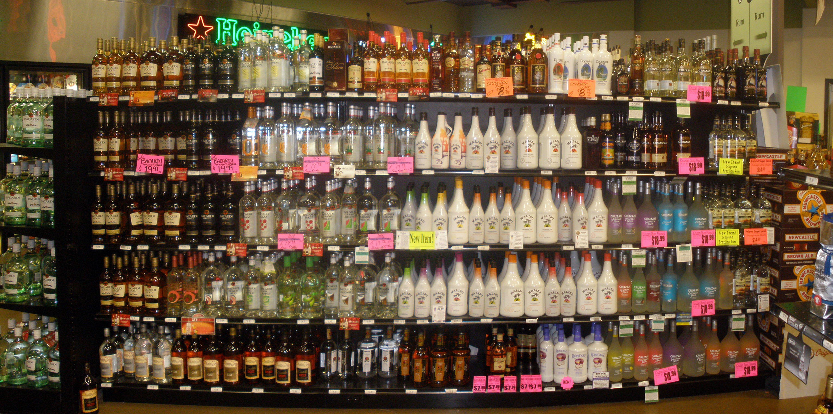
US
Rum Overview
• According to DISCUS, Rum consumption has grown 3.2% CAGR since 1997.
• At 24.9 million cases, Rum is the second largest distilled spirits category at 13%.
• The Super and Ultra-premium segments present great opportunity for new entrants with 2010 growth rates of 3.1 and 2.4% respectively.
• According to Nielsen, the 52-week period ending 9.17.11, Ultra-premiums were the fastest growing segment, up 11.7% by volume.
• Rum has not fully capitalized on the tremendous growth of the Super/Ultra-premium segments like Vodka & Tequila. RIO RUM is well poised to take this segment by storm!

Slide 14
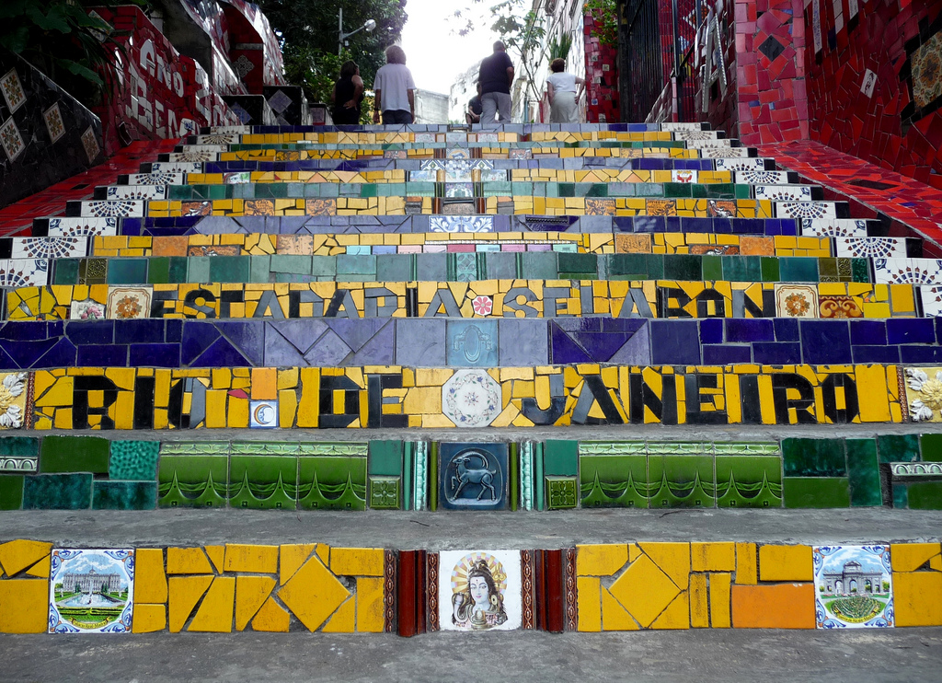
The RIO RUM Brand

Slide 15
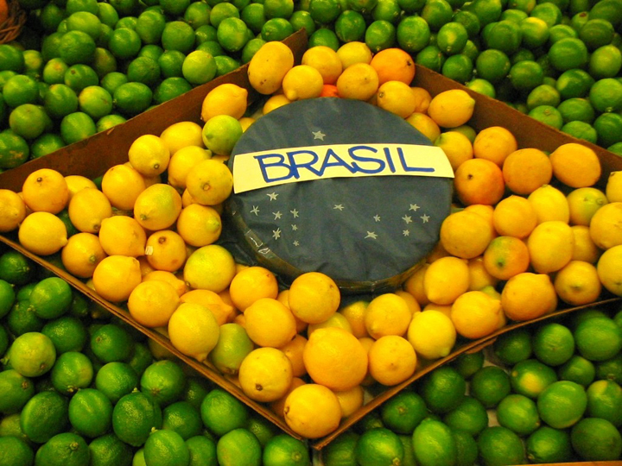
RIO RUM’s Competitive Advantages
• Exposure: RIO RUM will be well positioned to leverage media exposure and tourism rates that Rio de Janeiro will experience due to the forthcoming 2014 FIFA World Cup and the 2016 Olympic Games and will further quench America’s thirst for all things Brazilian.
• Packaging & Pedigree: We will fully express the handcrafted, small batch nature of the product through our unique package design, and leverage our 150+ year, award winning distilling history of Weber Haus.
• Behavior: Versus traditional imported Cachaças, RIO RUM will move beyond the Caipirinha and behave as a rum in the marketplace
• Look, Tone & Feel: While we pride ourselves on being classified as “Premium”, RIO RUM is a welcome respite from traditional elitism. RIO RUM will be positioned as the spirit of pure fun.

Slide 16
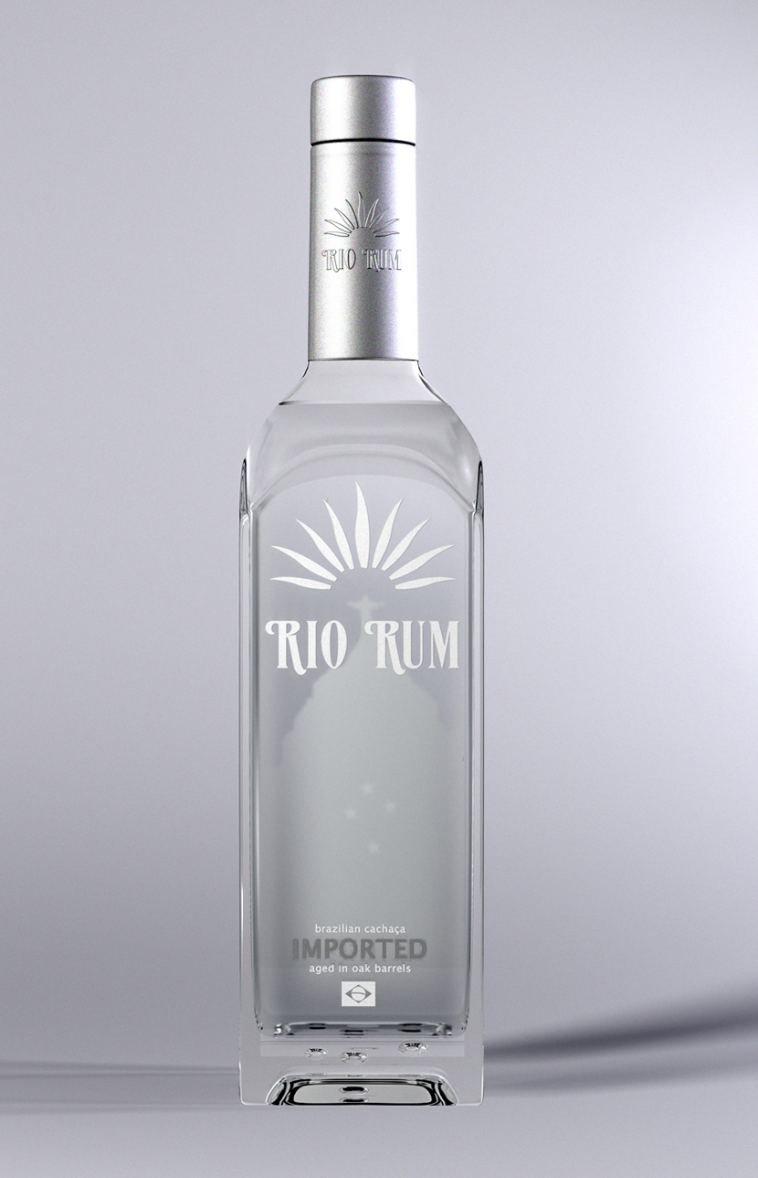
RIO RUM
Packaging
• Though contemporary in design at first glance, the logo and iconography were greatly influenced by the natural beauty of Rio de Janeiro.
• The etched, clear bottle highlights Christ The Redeemer, one of the most recognized icons of Brazil and one of the new Seven Wonders of the World.
• The stars make up the Cruzero do Sul. Found on the Brazilian flag, this constellation was used by sailors to determine the southern direction at sea. Furthermore, they point to Ivoti in the southern region, home of our award-winning distillery, Weber Haus.
• The shoulders of the bottle reflect the Carioca Aqueduct located in the vibrant neighborhood of Lapa, Rio De Janeiro .
• Bubbles found in the heavy glass base give the package a substantial, handcrafted feel.

Slide 17
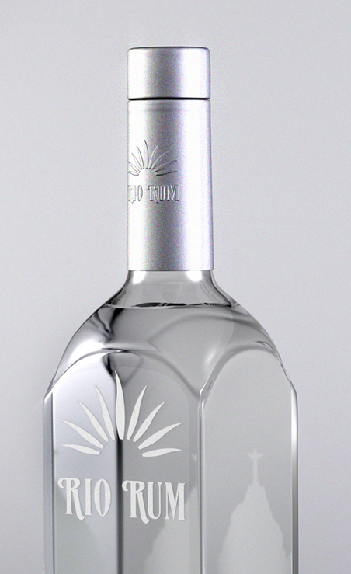
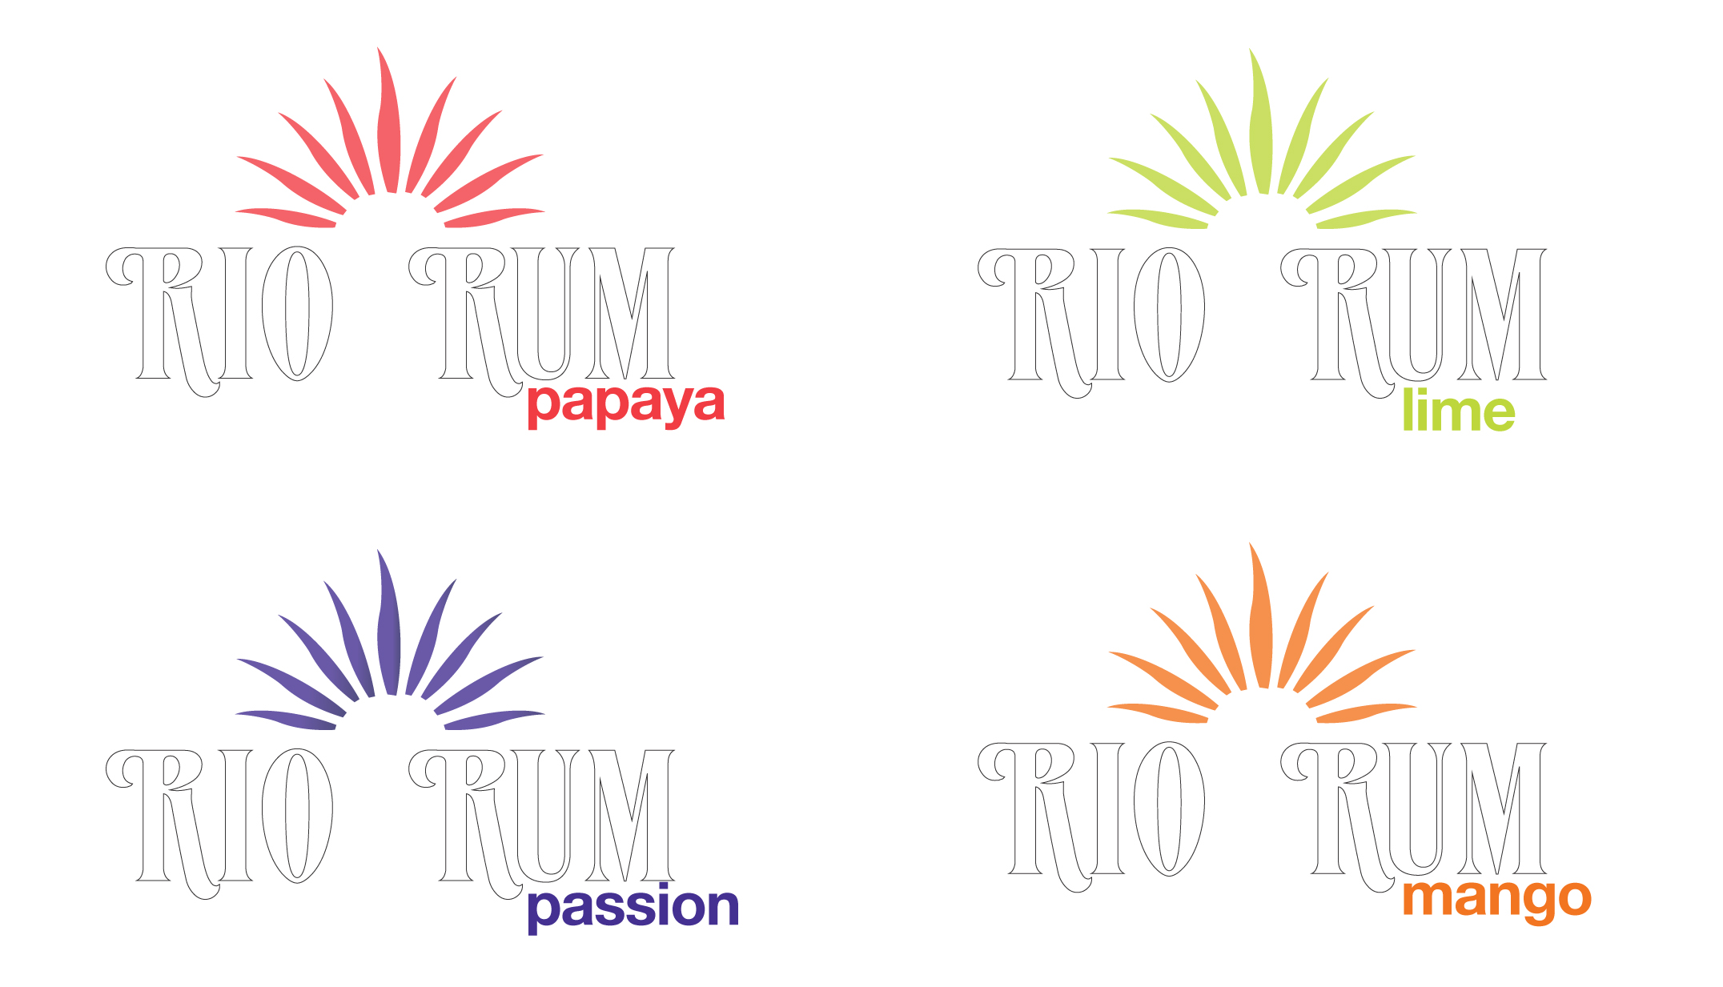
RIO RUM
Sizes/SRP/Flavors
Both Silver and Gold will be available in the following sizes Year 1:
• 1L
• 750 ML
• 50 ML
SRP is $28.99 and $34.99 respectively
Post Year 1 anticipate roll-out of 1 to 2 flavors annually. Specific flavors TBD: (Passion Fruit, Papaya, Mango, Coconut, Açai Berry, Cinnamon, Ginger)

Slide 18
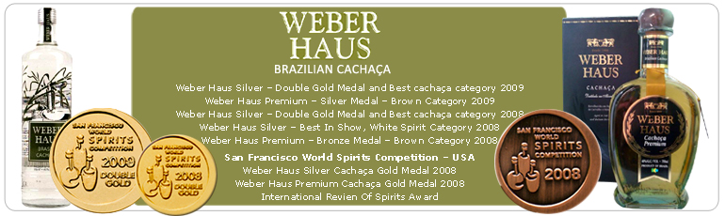

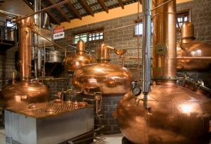
RIO RUM
Distillery
• RIO RUM has selected Weber Haus for production.
• Since 1848, the award-winning distillery has been making cachaça at their family owned estate in Ivoti, Rio Grande do Sul in the southern region of Brazil.
• Everything that goes into their cachaça is produced on the grounds of the estate.
• Weber Haus was one of the first distilleries to be certified by the National Institute of Metrology Normalization and Industrial Quality (INMETRO) the official accreditation body in Brazil.
• Weber Haus was the first distillery to make flavored cachaças and are one of the few distilleries with the capacity to produce "Certified Organic" cachaças.

Slide 19
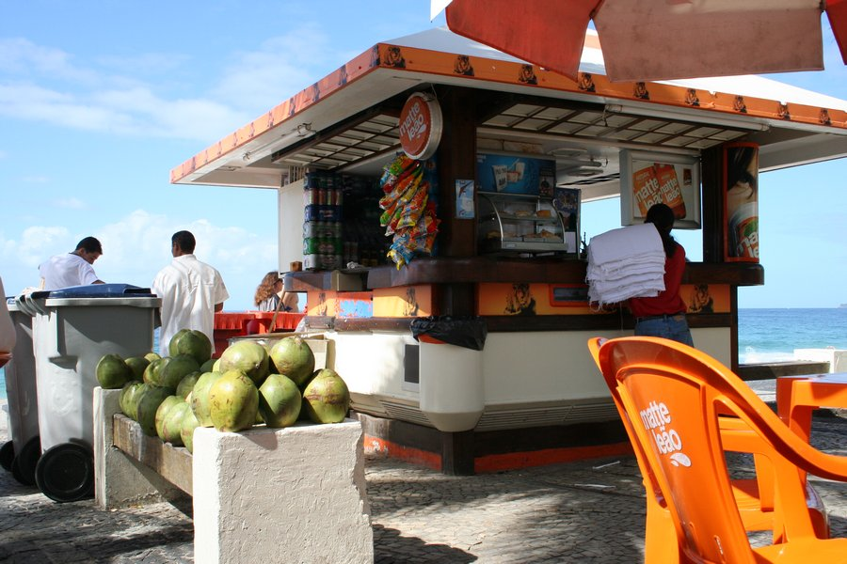
The RIO RUM Plan

Slide 20
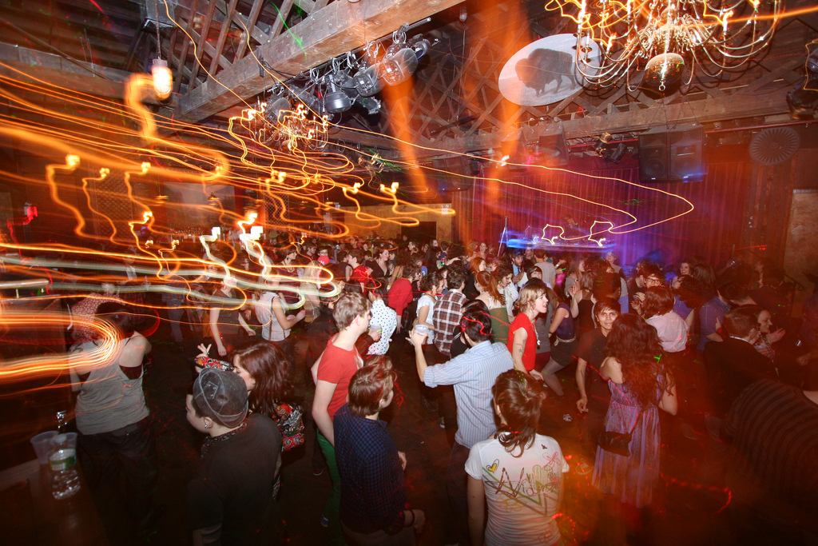
RIO RUM’s Target Audience
Versus a traditional demographic profile, RIO RUM will be targeted to those that “Celebrate Life”
Primary Target:
• Alternative Lifestyle (Gay)
• Millenials
Secondary Target:
• Women
• White Spirits Drinkers

Slide 21

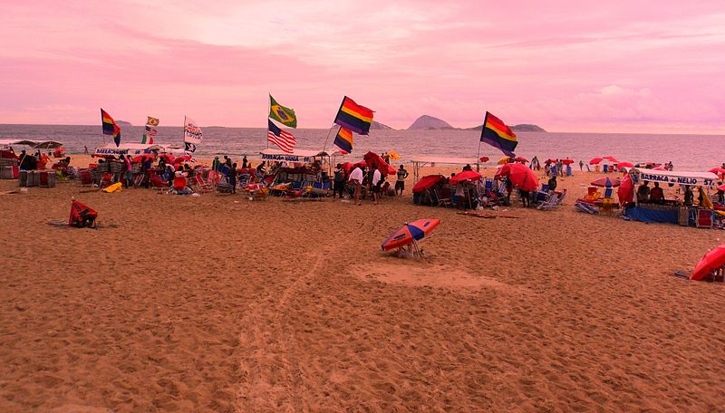
Alternative Lifestyle: A Snapshot
• 16.3+ million strong, with high geographic densities in cities such as New York, Los Angeles, Chicago and San Francisco.
• ”Own” products and services that support and embrace their lifestyle.
• Represent $830+ billion in purchasing power, with high disposable incomes. Bob Witeck, CEO of Witeck-Combs Communications, referencing a new online study, said that “gay consumers consistently budget more discretionary dollars towards travel, even during downturns in the economy such as we face now.”
• LBGT Travel is highly developed in Brazil, with over 6000 registered LGBT friendly hotels and hostels as nearly 26% of visitors lead alternative lifestyles!
• The city of Rio de Janeiro was elected the best LGBT destination in the world as well as the “sexiest” city according to the LOGO channel and TripOutGayTravel.
• With more than 3 million attendees every year since 2006, including an estimated 400,000 tourists annually, Sao Paulo Gay Pride is the best-attended gay pride event in the entire world!

Slide 22
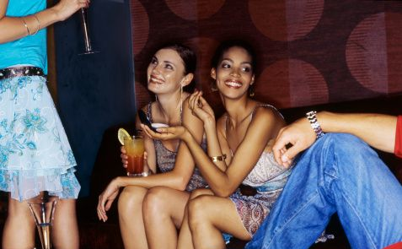
Millenials (Gen Y): A Snapshot
• Born between 1976 and 1995, they are 80 million strong (26% of population) and represent the future of brands.
• $200+ billion in purchasing power, they are highly experimental and promiscuous in their drinking behavior.
•Also known as the “fingertip generation”, they were raised on the internet and are engaged in social media, craving new experiences that have “social currency.”
Some rules of the road:
• Images- Millennials think in images, “the language of story-telling”
• Stories- Millennials remember stories, not facts. Stories provide an opportunity for engagement where facts don’t.
• Messages - Consumers will integrate your brand message with their own personal brand message.
• Authenticity - Millennials don’t want to connect with you on social media for the hell of it; they want authenticity, relevance, and emotion.

Slide 23
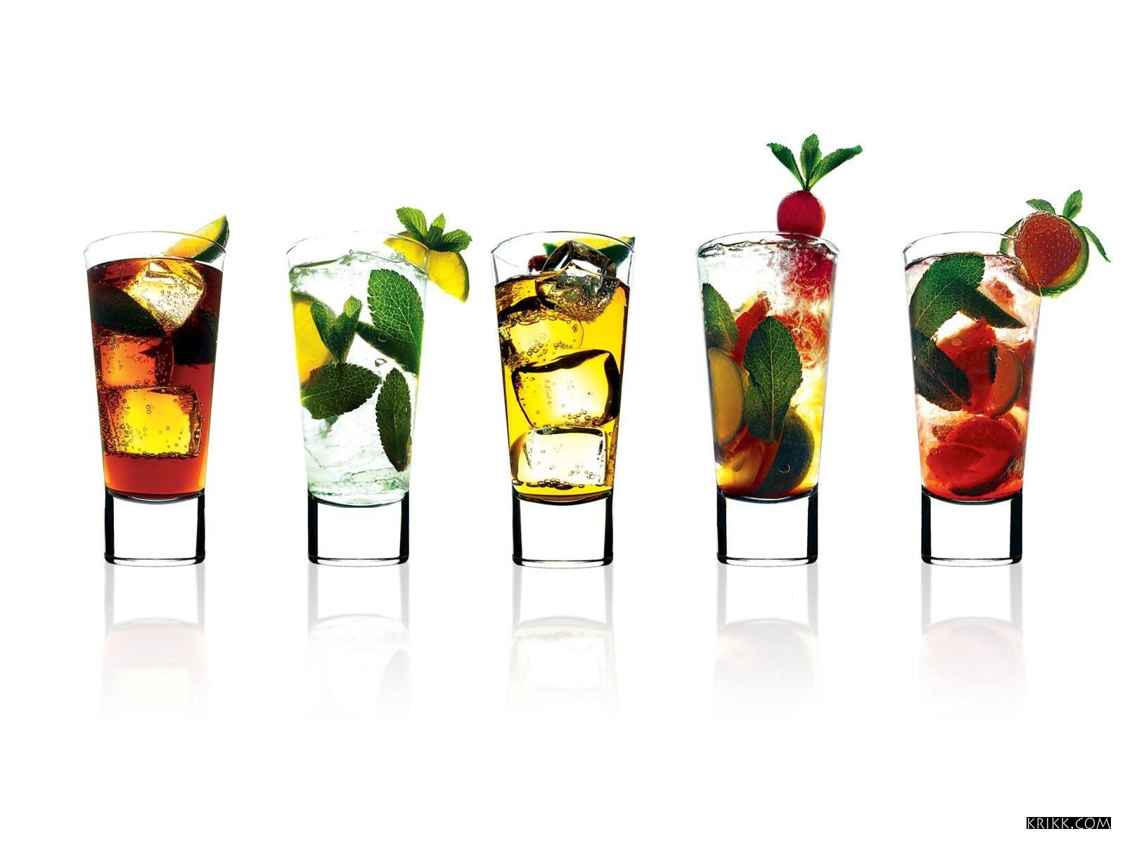
Beyond The Caipirinha
• While the Caipirinha may be the national cocktail of Brazil, we believe that there’s much greater opportunity to source volume if we behave like a rum.
• Brazilian Rum as a spirit has heritage and authenticity – not a new, fabricated spirit making it easy to differentiate from other rums
• Ultra premium rum as a category is underdeveloped and ripe for expansion
• Consumers are interested in new mixed drinks. Fits well with mixability.
• Market for mixable white spirits is huge and growing
• Key influencers (mixologists, bloggers, etc.) interested in new ideas and news
• Excellent potential to capitalize on consumers’ interest in small, handcrafted/artisanal products
• Consumer interest in and willingness to pay for imported super-premium products and perceived differences (e.g. anejo or 100% blue agave for tequila)

Slide 24
Distribution: Years 1-3+
Y1
Y2
Y3+
Chelsea & Meat Packing Dist. NYC
WA
MN
MA
WI
MI
San Francisco
NY
NV
Chicago
OH
PA
IL
Los Angeles
NJ
CT
CA
Dallas/Austin/
San Antonio
MD
GA
Duty Free & Travel
- Cruise Lines
- Caribbean
- GR, FR, UK,ESP
Rio de Janeiro, Brazil
- led by Brazilian Distiller
TX
Miami Beach Ft. Lauderdale
FL

Slide 25
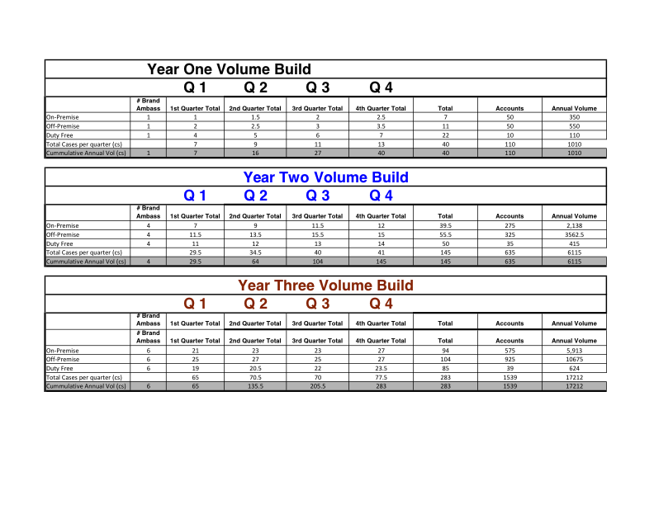
Years 1-3
Volume Targets

Slide 26
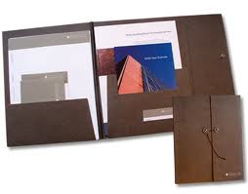

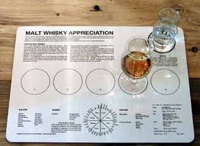
Sales Support
• Sales Sheets
• Sales Folder
• CD Rom
• Tasting Kit/Mat
ART IS FPO

Slide 27
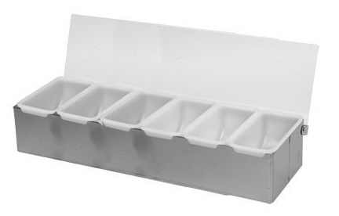

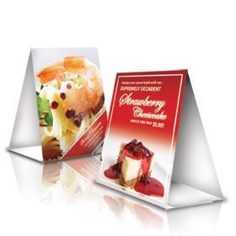

On-Premise
Support
• “Simple Drink” menus highlight the RIO RUM bar call…”RIO & Coke”, “RIO & Red Bull”, RIO & 7, RIO Colada, RIO Margarita…
• Branded Napkin Holders/Napkins
• Branded Condiment Trays
• Branded Gutter Mats
• Lighted Back Bar Pedestal
ART IS FPO

Slide 28
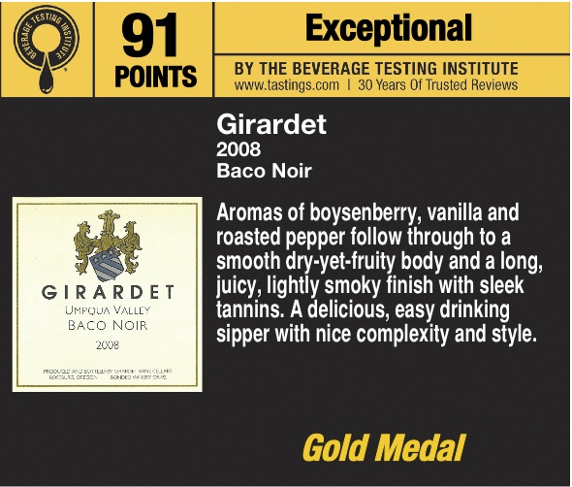
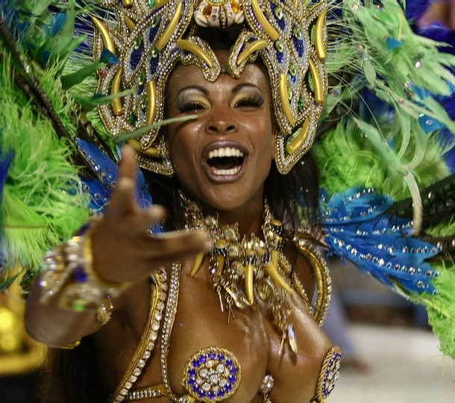
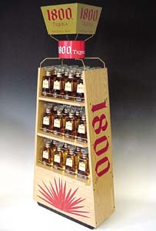
Off-Premise
Support
• Shelf Talkers
• Window Clings
• In-Store Posters
• Neck-Tags
• End Caps/Display Units
ART IS FPO

Slide 29
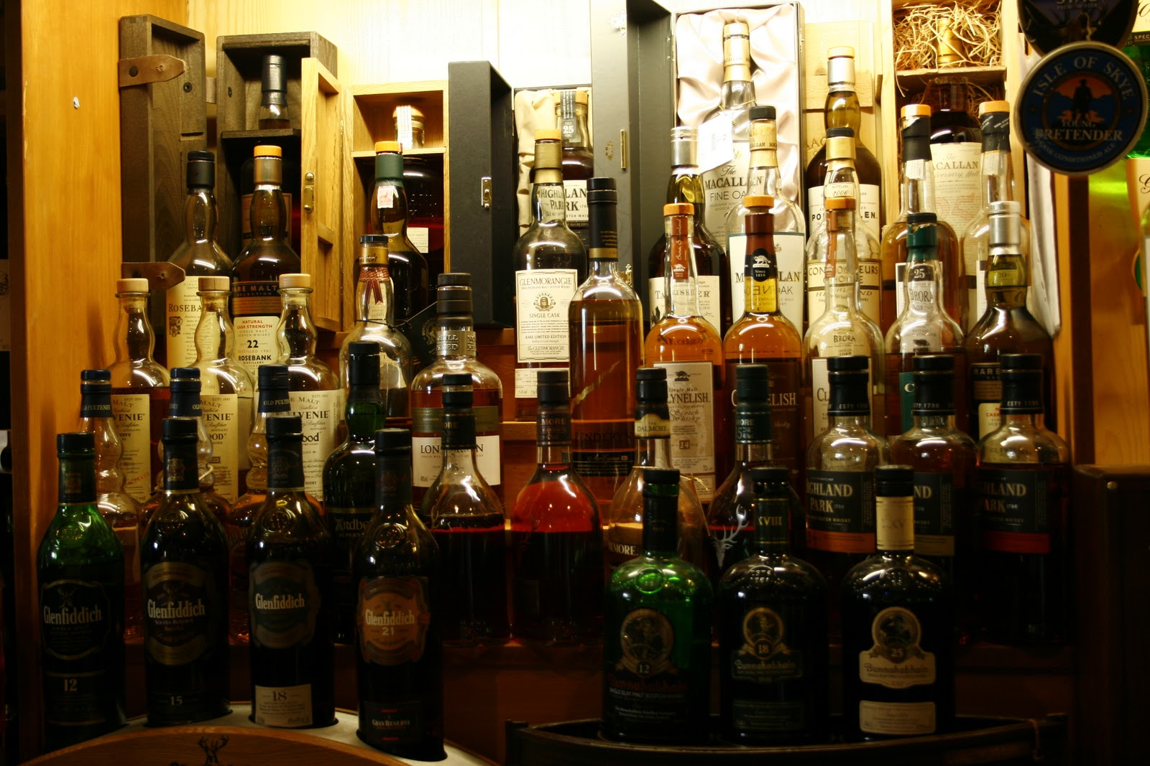
Perfect Shelf Set/Back Bar
ART IS FPO

Slide 30
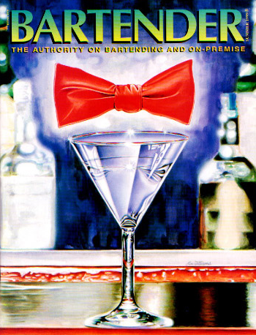
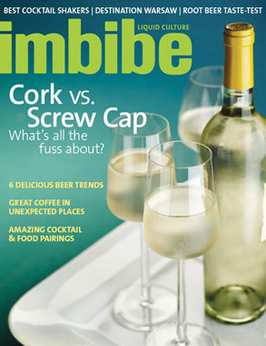
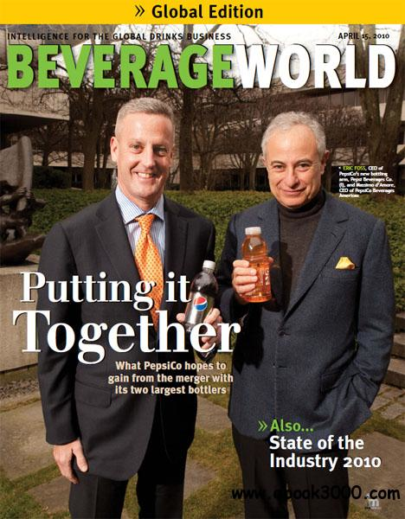
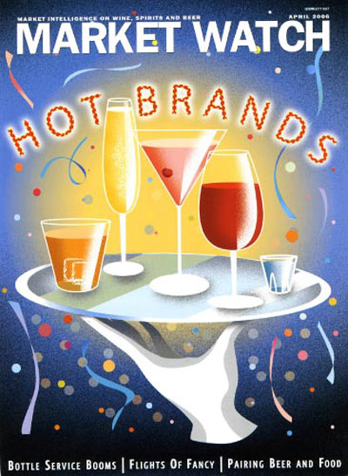
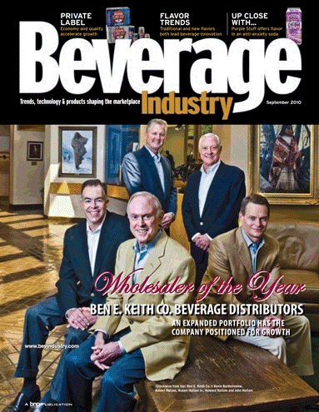
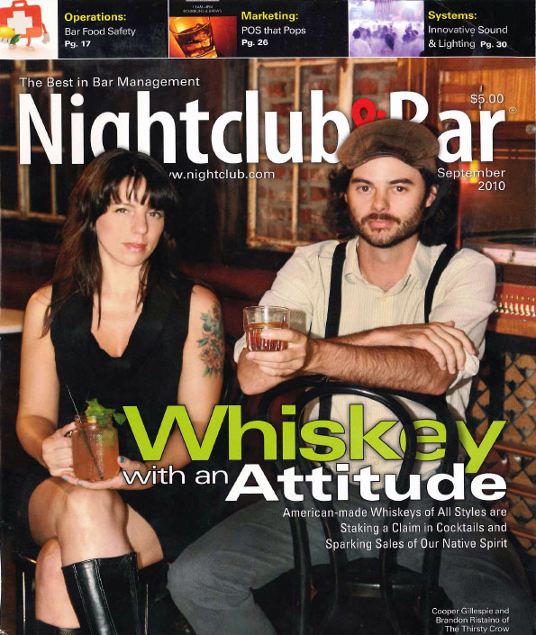
Trade Support
• Imbibe
• Beverage Industry
• The Tasting Panel
• Market Watch
• Nightclub & Bar
• Beverage World
• Bartender Magazine

Slide 31

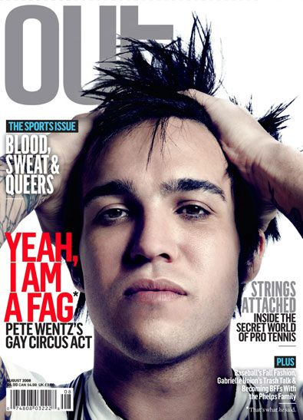
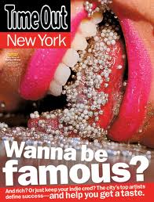
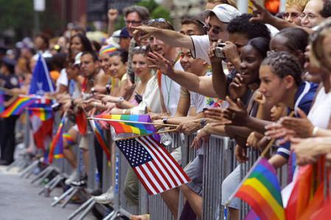

Consumer Support
• LBGT Friendly Publications
Out
The Advocate
Metrosource
Next
• Entertainment/Culture
Time Out NY
L-Magazine
Juxtapoz
Paper
Flavorpill.com
Dailycandy.com
• Key Events
Gay Pride Parade
Brazil Independence Day
Fire Island Events (The Pines)
NYC Food & Wine Festival
• Other
Targeted OOH
PR/Social Media

Slide 32

The RIO RUM Team

Slide 33
The Principals/Ownership
Jonathan Flaum is a native New Yorker. Jonathan's 14-year history with Brazil has been both work and pleasure. He has run adventure travel tours through Brazil and has been an investor in an eco-lodge. Jonathan has worked in the film and advertising industry for the last fifteen years.
Adam Jenkins is from New Zealand and has worked in the film and advertising industry for the last fifteen years. He currently owns a media company and has lived in New York for the last six years.
Jonathan Flaum and Adam Jenkins currently own 100% of the business.
ART IS FPO

Slide 34
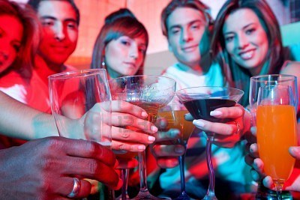
Key Partners
• The James Gang
James Verrier – Principal
• Brand Action Team (BAT)
Jeff Grindrod – Managing Partner
Steve Raye – Managing Partner
Denise Menefee – Executive Director
• MHW, LLC
John Beaudette
• Beacon Beverage
Dave Stringfellow
• Next-Level Marketing
Mike Ginley

Slide 35




Key Partners
• The James Gang
James Verrier – Principal
• Brand Action Team (BAT)
Jeff Grindrod – Managing Partner
Steve Raye – Managing Partner
Denise Menefee – Executive Director
• MHW, LLC
John Beaudette
• Beacon Beverage
Dave Stringfellow
• Next-Level Marketing
Mike Ginley

Slide 36
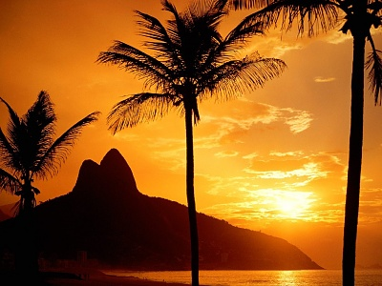
Current Status
• Rio Rum Trademark (word mark & design) filed – serial #77599673
• Weber Haus secured as production partner
• MHW, LLC, Genesis has been selected as distribution partner
• TTB approval finalized
• Finalizing packaging, COLA approval pending

Slide 37
This document, and any attachments thereto are solely the property of rio rum llc and contain legally privileged and/or confidential information. you are hereby notified that any dissemination, distribution, printing or copying of this document, and any attachment thereto, is strictly prohibited.

